Slide 1


Philippine Air Force
Flight Plan 2028
AFP Governance Exposition 2014
Main Restaurant, AFPCOC, CGEA
17 December2014

Slide 2
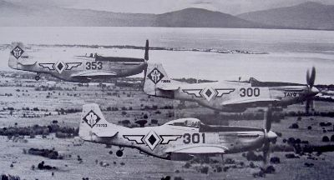
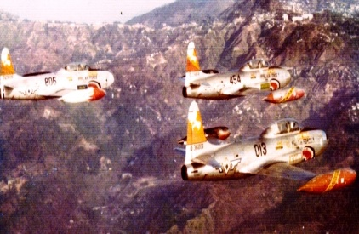
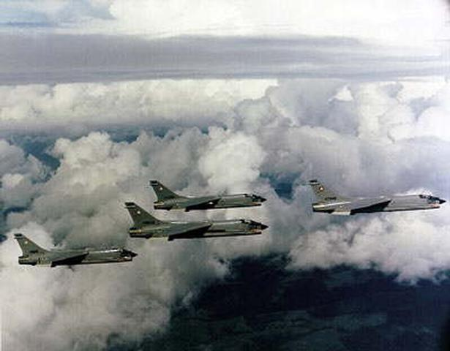
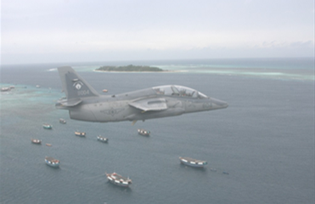

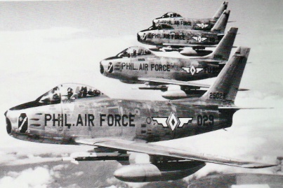
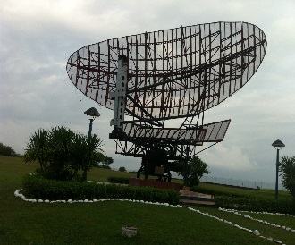
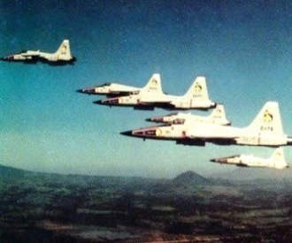
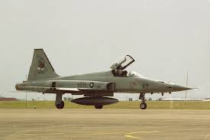
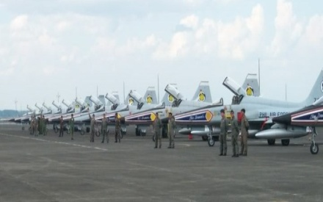
Philippine Air Defense Capability
Historical Timeline
1947
103 P-51D “Mustang”
1955
25 T-33A & 2 RT-33
1978-1988
25 F-8H “Crusaders”
25 S-211
Now with only 3 Operational AS-211 Aircraft and 1 Radar with limited capability
1950’s
1960’s – 1970’s
1980’s
1990’s – 2005
50 F-86F & 20 F-86D
“Sabre Jets”
1957
AN/APS-20 Radar
Early 1960
22 F-5A/B(US)
1965
3 F-5A(Taiwan) & 1 F-5B
1989
8 F-5A(S.Korea) & 2 F-5B(Jordan)
1990
PAF Enters the Supersonic Age

Slide 3
Philippine Air Defense Capability
Force Comparison
ASIAN COUNTRIES | FIGHTER AIRCRAFT | AD RADARS | MISSILE DEFENSE | BALLISTIC MISSILE | NUCLEAR ARMS
CHINA | 1082 | Equipped | Equipped | Equipped | Equipped
S KOREA | 448 | Equipped | Equipped | Equipped | None
TAIWAN | 359 | Equipped | Equipped | None | None
JAPAN | 297 | Equipped | Equipped | None | None
VIETNAM | 208 | Equipped | Equipped | None | None
THAILAND | 55 | Equipped | Equipped | None | None
INDONESIA | 48 | Equipped | Equipped | None | None
MALAYSIA | 42 | Equipped | Equipped | None | None
PHILIPPINES | 0 | None | None | None | None
CAMBODIA | 0 | None | None | None | None
BRUNEI | 0 | None | None | None | None
Reference: Jane’s Defense Magazine 09-Jul-2012

Slide 4
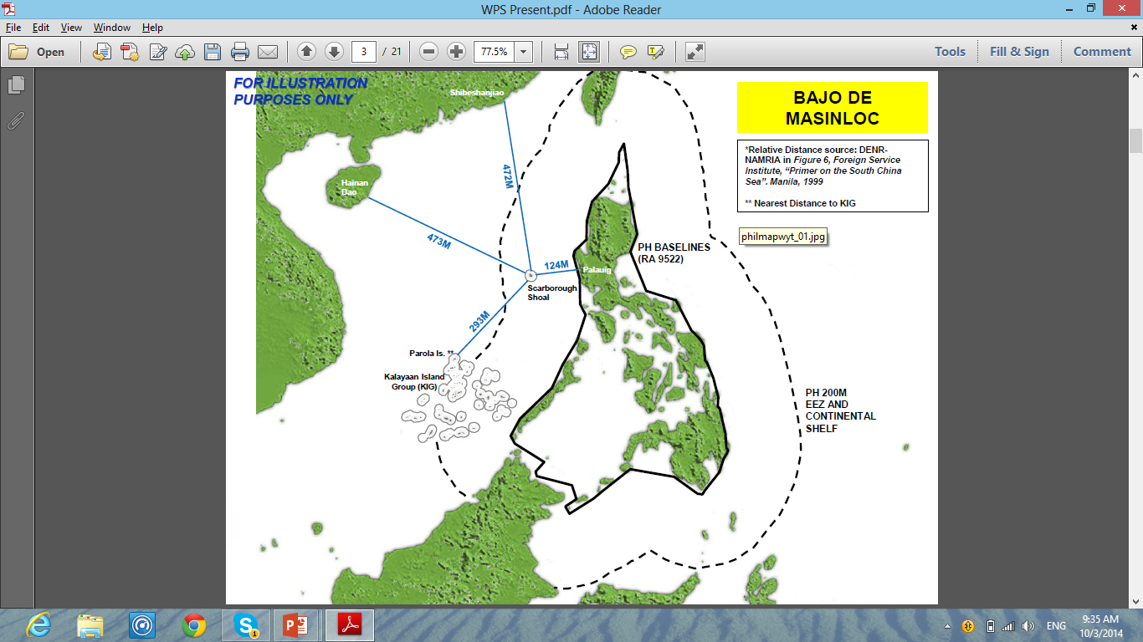
R.A. 9522 PH Baselines Law
Defined “Regime of Islands”:
Bajo De Masinloc
(Scarborough Shoal)
Kalayaan Island Group
Land Area:
300,000 sq. km.
Coastline:
36,289 km

Slide 5
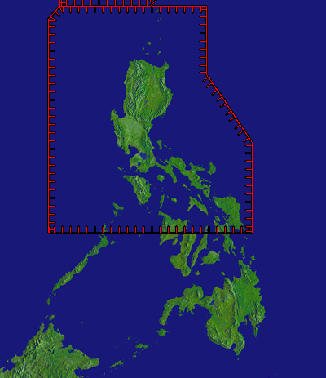
Administrative Order 222
JADIZ
TADIZ
Establishment of the Philippine Air Defense Identification Zone (PADIZ) in 1953
PADIZ

Slide 6
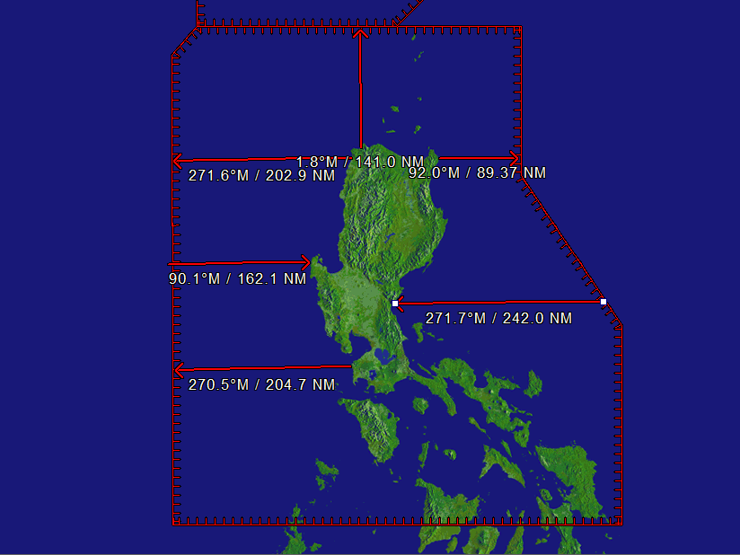
PADIZ

Slide 7
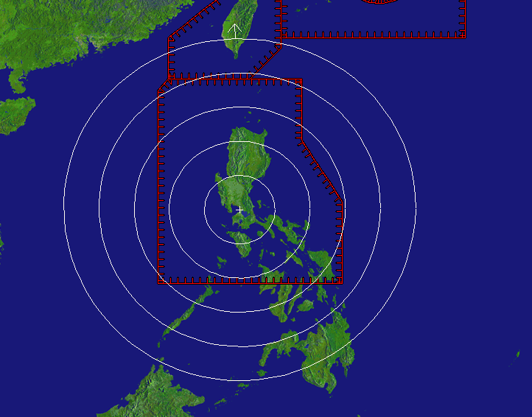
PADIZ

Slide 8
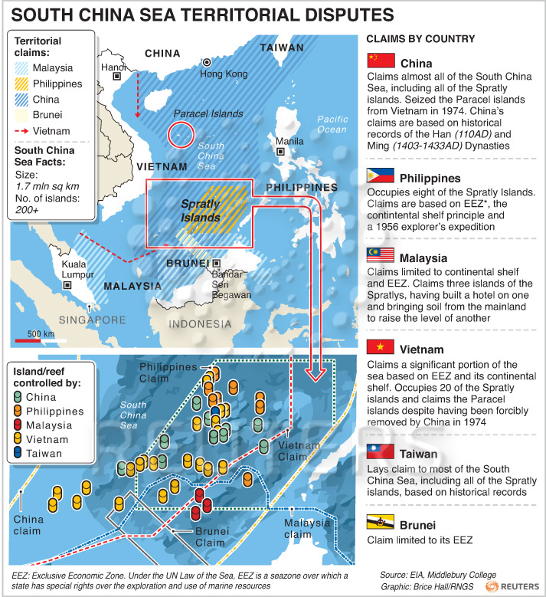
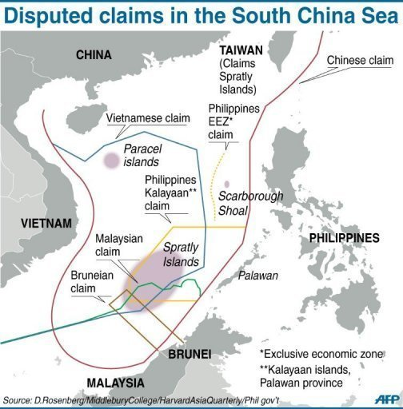
West Philippine Sea Claims
Reference: Council on Foreign Relations

Slide 9
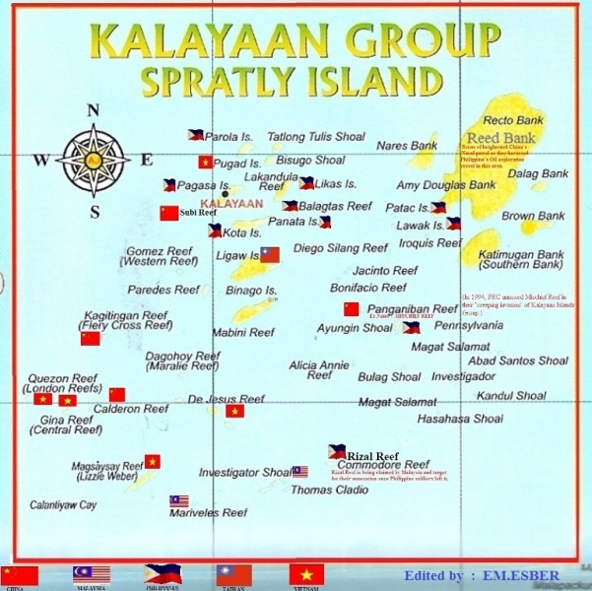
KIG

Slide 10
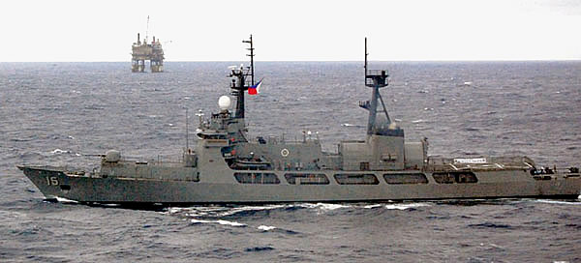
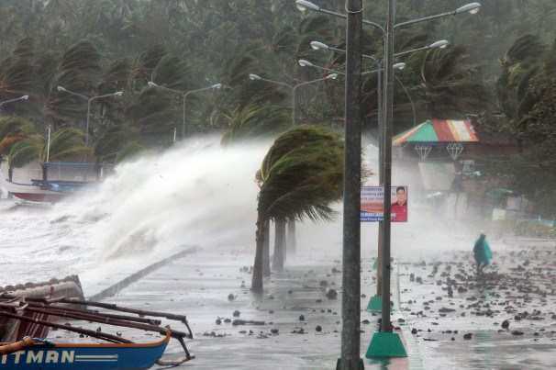


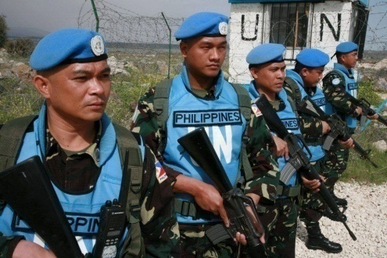
Core Security Concerns
Territorial Defense
Maritime Security
Internal Security
Natural Disasters
Cyber Security
Global Peace & Security
Reference: Defense Strategic Planning System 2015-2020

Slide 11

E.O. 292 Administrative Code of 1987
(Book IV, Title VIII, Chapter 8, Sec. 50)
“The Philippine Air Force shall be responsible for the air defense of the Philippines.”
(Book IV, Title VIII, Chapter 8, Sec. 51)
“Organize, train, and equip forces for prompt and sustained air operations for the defense of the Philippines.”

Slide 12
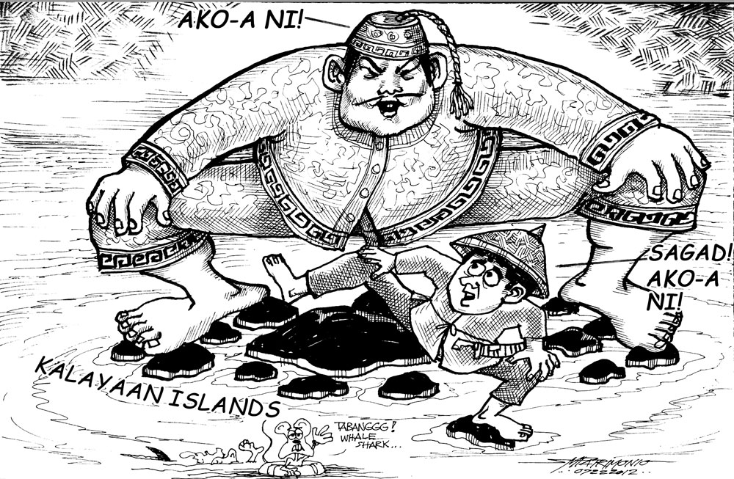
Need to Transform
PAF Weaknesses
Limited equipment, bases, and facilities for TD
Inadequate training for TD
Absence of established doctrines for TD
Organization not configured for TD
Image Courtesy of: Negros Chronicle

Slide 13
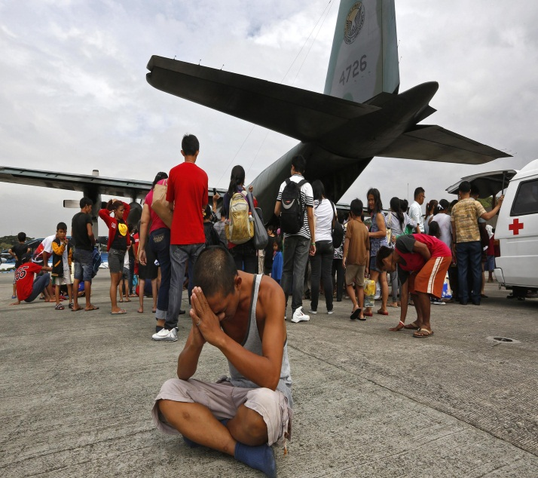
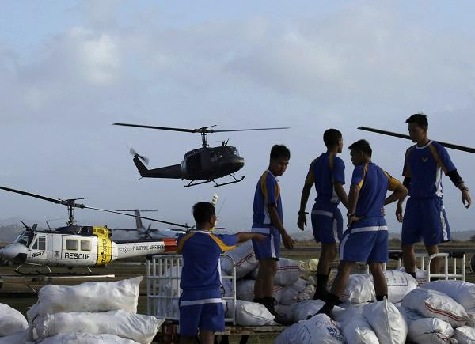
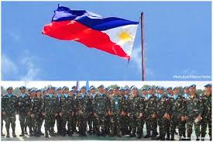
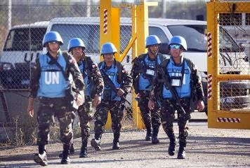
Need to Transform
PAF Weaknesses
Limited capability for Humanitarian Assistance and Disaster Response Operations
Limited Equipage for International Peacekeeping Operations

Slide 14
AFP Modernization Program
R.A. 7898 (AFP Modernization Act of 1995)
R.A. 10349 (Revised AFP Modernization Act of 2012)
P35B by the end of 2011 for Capability Upgrade
P85B for the next 5 years
1995
2011
2012
2017

Slide 15
Take-off Towards Transformation

Slide 16
Vision, Mission and Core Values
VISION
A professional and competent Air Force responsive to national security and development.
To organize, train, equip, maintain
and provide forces in order to conduct prompt and sustained air operations to accomplish the AFP mission.
Integrity ◆ Service Above Self
Teamwork ◆ Excellence ◆ Professionalism
MISSION
CORE VALUES

Slide 17
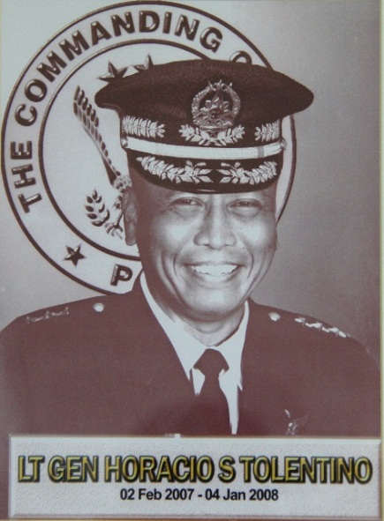
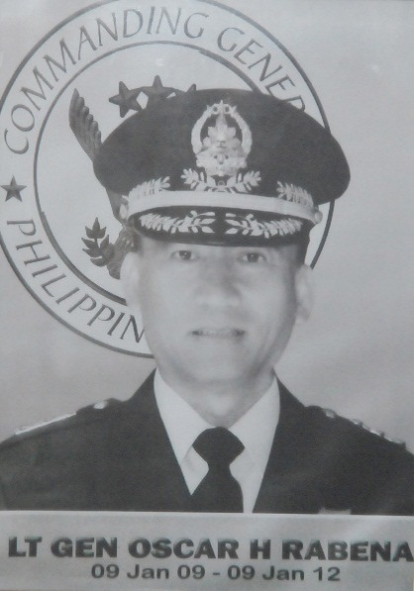
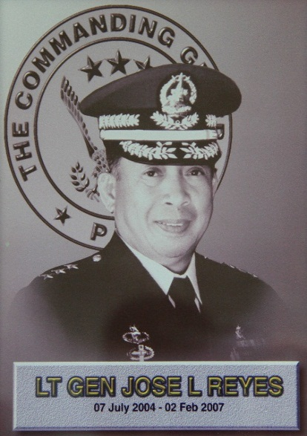
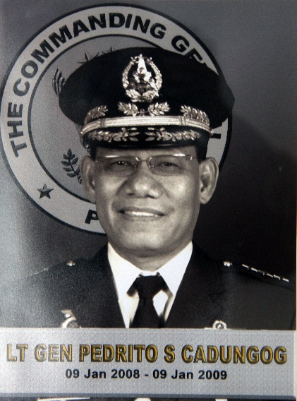
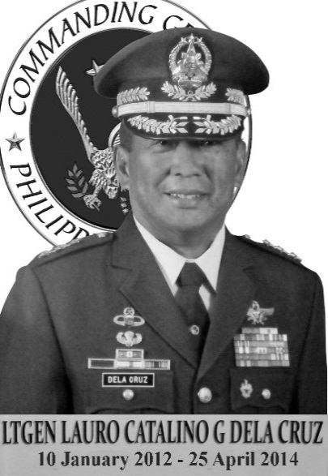
Towards PAF Transformation
“A.C.T.I.O.N. – AIR FORCE”
“InSTEP Air Force:
Integrity, Service, Teamwork, Excellence, Professionalism”
“Join Up, Power Up:
Do More With Less”
“POWER UP, PAF”
“T.E.A.M. Air Force”
2004-2007
2007-2008
2008-2009
2009-2012
2012-2014

Slide 18
SOAR HIGH PAF
  Sustain transformation for Territorial Defense, Internal Security and National Development
  Optimize international defense cooperation and interagency partnerships
  Accelerate improvements to force level command and control
  Respond rapidly to crisis and calamities
  Harmonize efforts towards the whole of nation approach
  Institute good governance and transformation
  Generate superior strategies and doctrines to leverage on air power
  Harness talents and expertise
  Promote InSTEP and the Rule of Law
  Adopt mechanisms for the judicious and efficient utilization of resources
  Fast track capability development

Slide 19
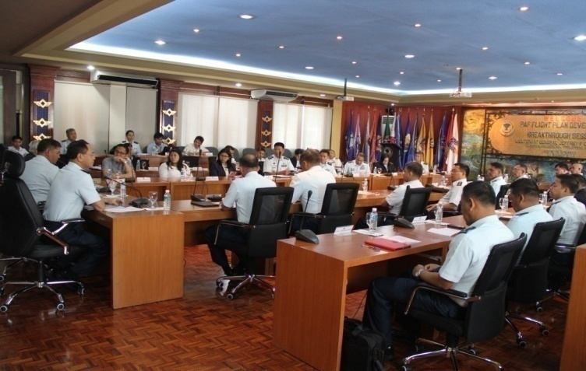

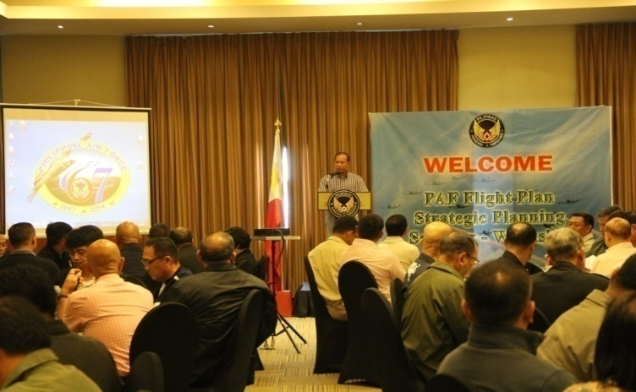

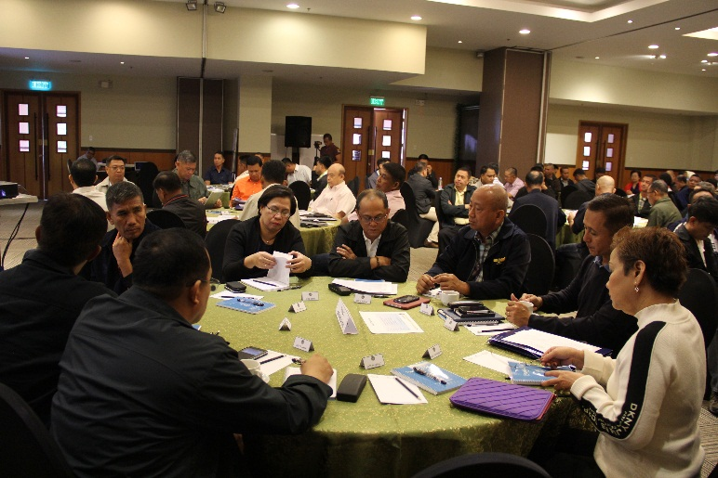
PAF-ISA Partnership

Slide 20
Breakthrough Goals
2022
Build our capability
to detect, identify, intercept and neutralize intrusions into the Philippine territory from Area Readiness 3 to Area Readiness 1.
Build our capability
to detect, identify, intercept and neutralize intrusions in the PADIZ and the West PH Sea from Area Readiness 4 to Area Readiness 3.
2028
AR1: 85-100% of PH Territory
AR2: 75-84% of PH Territory
AR3: 51-74% of PH Territory (PADIZ + WPS)
AR4: 0-50% of PH Territory

Slide 21
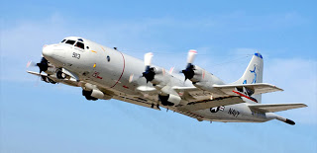
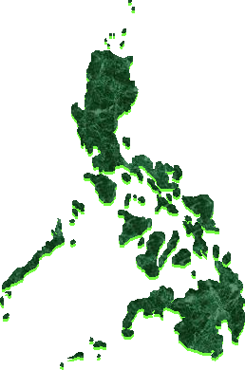
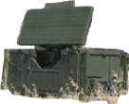
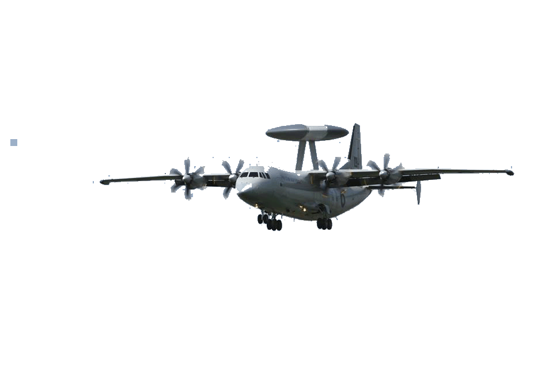
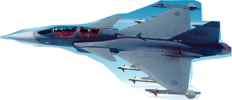
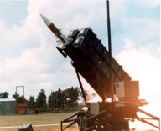
Breakthrough Goal
2028
Build our capability to detect, identify, intercept and neutralize intrusions into the Philippine territory from Area Readiness 3 to Area Readiness 1.
Detect
RADAR
LRPA
Identify
AEWACS
Intercept
SAA/LIFT
MRF
Neutralize
MDS

Slide 22
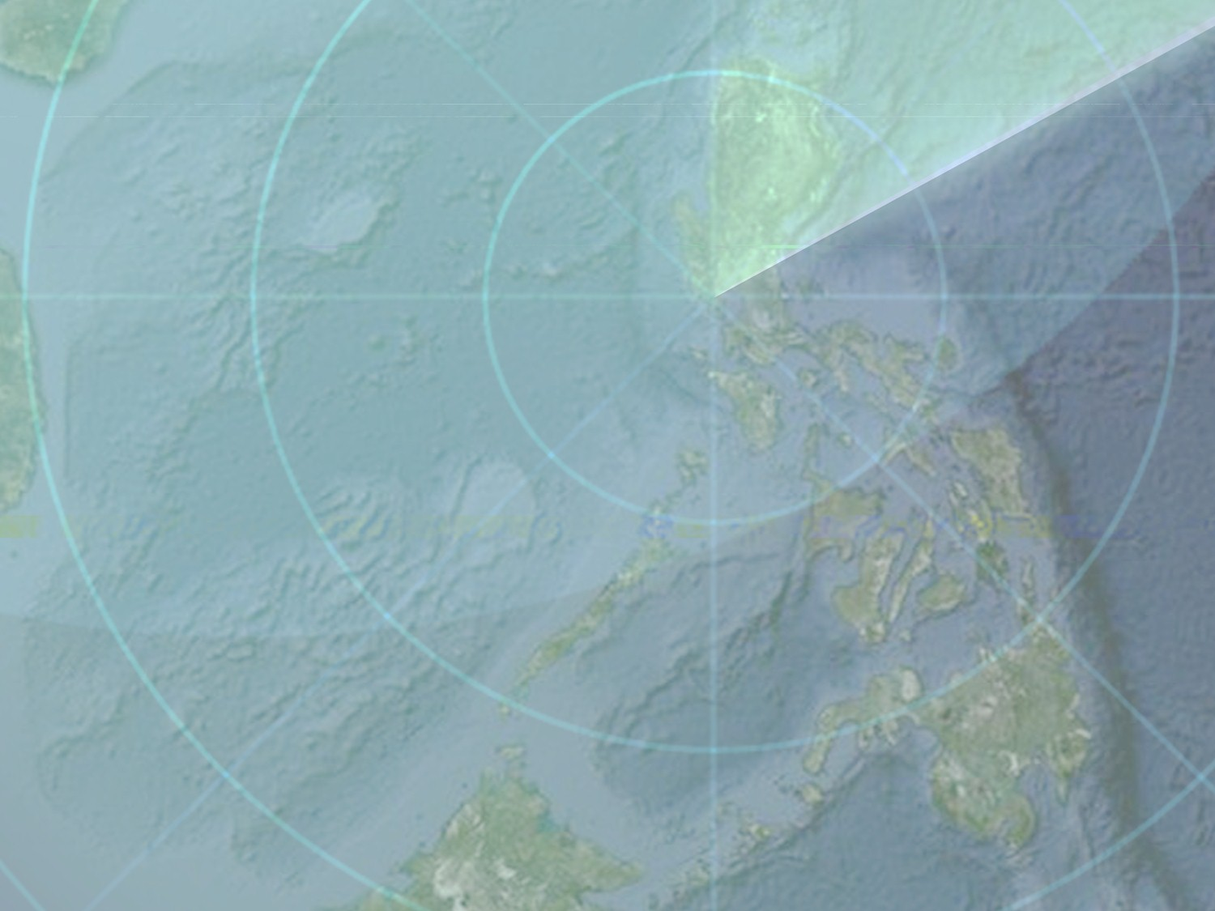
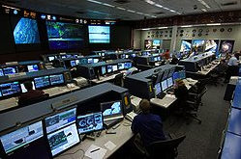
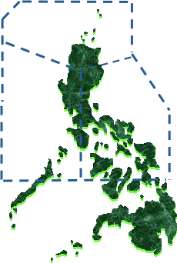
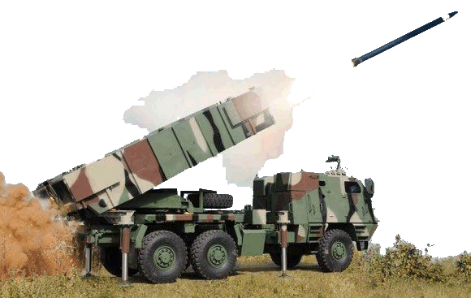
Breakthrough Goal
Build our capability to detect, identify, intercept and neutralize intrusions in the Philippine Air Defense Identification Zone (PADIZ) and the West PH Sea from Area Readiness 4 to Area Readiness 3.
2022
Detect
RADAR
Identify
PADIZ
AEWACS
LRPA
Intercept
SAA/LIFT
MRF
Neutralize
MDS

Slide 23
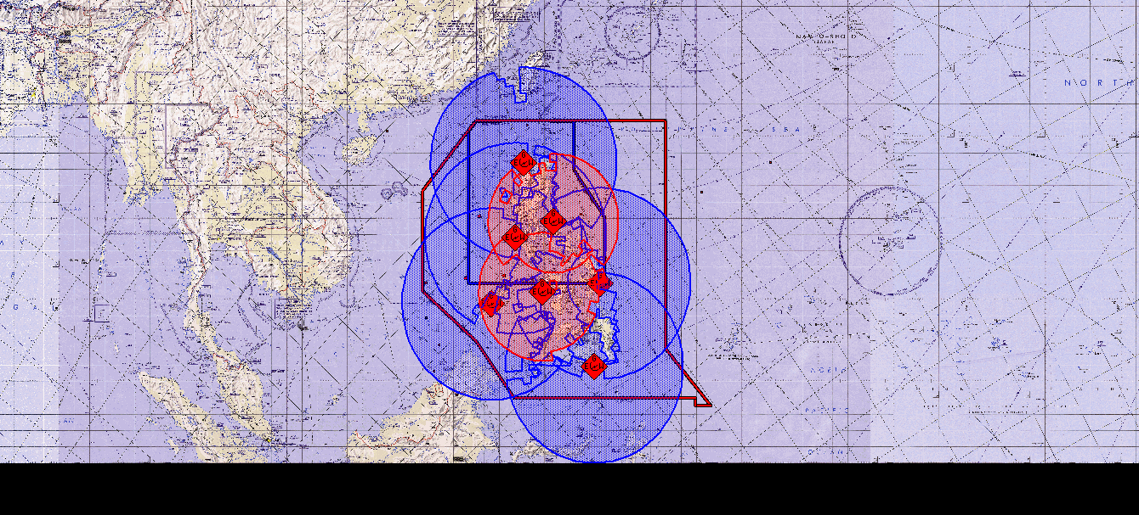
Radar Sites
First 3 Radar Sites:
Lubang, Occ. Mindoro
Pasuquin, Ilocos Norte
Mt Salakot , Palawan
2
4
Future Radar Sites:
Panganiban, Cam Norte
Balut Island
Guiuan, Samar
Anini-y, Antique
1
6
7
3
5
Legend:
Shaded Area – Radar Coverage

Slide 24
VISION A professional and competent Air Force
responsive to national security and development.
Philippine Air Force
FLIGHT PLAN 2028
Build capability to detect, identify, intercept and neutralize intrusions in the Philippine Air Defense Identification Zone and West Philippine Sea by 2022 and the entire Philippines by 2028.
Breakthrough
Core Process
Restructure air defense organization into an integrated command.
ORGANIZATION
TRAINING
Provide training for mission-essential tasks
to support air defense capability upgrade.
Acquire and upgrade air defense equipment complemented by research and development for Territorial Defense (TD)
EQUIPMENT
AND
RESEARCH & DEVELOPMENT
HUMAN RESOURCES
Provide and sustain the best talents for air defense prioritizing Air Defense Organization.
DOCTRINES
Develop doctrines relevant to air defense operations at the strategic, operational and tactical levels.
BASE FACILITIES
Upgrade base facilities and support system following an approved master development plan.
Support Process
Pursue military values towards effective mission performance of Strategic Units
Secure stakeholders’ support to generate adequate funding for the Flight Plan.
VALUES
FINANCE
MISSION To organize, train, equip, maintain and provide forces to conduct prompt and sustained air operations to accomplish the AFP mission.
Core Values Integrity ◆ Service Above Self
◆ Teamwork ◆ Excellence ◆ Professionalism

Slide 25
Strategic Change Agenda
Internal Security Operations | Focus | Territorial Defense
Unable to Enforce PADIZ | Capability | Full Air Defense Capability for PADIZ and West PH Sea
Air Defense Wing | Organization | Air Defense Command
Legacy Equipment | Equipment | Modern Equipment
Limited to Existing Equipment | Training | Specialized for Modern Equipment
Based on Operational Requirements | Bases Development | Based on Master Development Plan
Warm Bodies Recruitment | HR System | Strategic, Competency-Based Recruitment
Manual Maintenance Capability for Legacy Equipment | Support System | Automated Maintenance Capability for Modern Equipment
Tactical needs driven | Research and Development | Strategic needs driven, Collaborative, and Multi-Disciplinary
Values Formation and Skills Training | Organizational Culture | Values Integration into Skills Training
Annual Funding from GAA | Funding | GAA + Supplemental Budget + Multi-Year Funding
FROM
TO
Notes:
(SLIDE 17) THE PAF STRATEGIC CHANGE AGENDA IN THIS DIAGRAM ILLUSTRATES THE TRANSFORMATION NEEDED BY THE ORGANIZATION IN THE FOLLOWING ASPECTS, FOCUS, CAPABILITY, ORGANIZATION, EQUIPMENT, TRAINING, BASE DEVELOPMENT, HR SYSTEM, SUPPORT SYSTEM, RESEARCH AND DEVELOPMENT, ORGANIZATIONAL CULTURE, FUNDING, RESPECTIVELY.

Slide 26
VISION A professional and competent Air Force
responsive to national security and development.
Philippine Air Force
FLIGHT PLAN 2022
Build capability to detect, identify, intercept and neutralize intrusions in the PADIZ and West PH Sea from Area Readiness 4
to Area Readiness 3 by 2022.
Breakthrough
Organization
Restructure air defense organization into an integrated command.
Core Process
ORGANIZATION
TRAINING
EQUIPMENT
AND
RESEARCH & DEVELOPMENT
HUMAN RESOURCE
DOCTRINES
BASE FACILITIES
Support Process
VALUES
FINANCE
MISSION To organize, train, equip, maintain and provide forces to conduct prompt and sustained air operations to accomplish the AFP mission.
Core Values Integrity ◆ Service Above Self
◆ Teamwork ◆ Excellence ◆ Professionalism

Slide 27

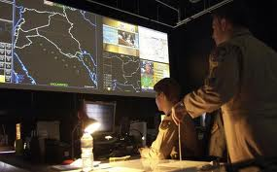
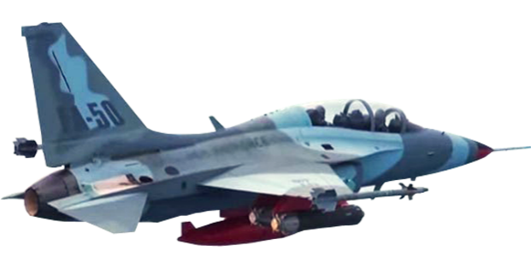
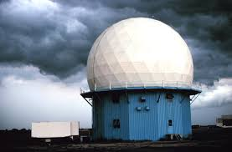
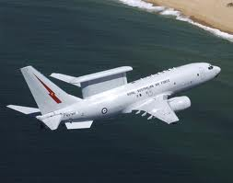
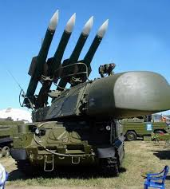
Organization
HPAF
Tactical Divisions and Support Commands
1ST AD
2ND AD
3RD AD
ALC
AETC
AFRC
ADC
355AEW
600ABW
560ABW
530ABW
5FW
AFOS
PAFFS
ARCens
410MW
TOGs
TOGs
TOGs
580ACWW
PAFOCS
NCOS
780GBADG
AFWR
420SW
PAFTSTS
BMTS
ASSW
440AMG
550ABG
AFRDC
Tactical and Support Wings
ADW
15SW
205THW
220AW
250PAW
520ABW
570CTW
710SPOW
Air Force Wide-Support and Separate Units
300AISG
505SRG
900AFWG
950CEISG
AFSSG
HSSG
AFAC
AFFC
PAFPMC
API
AFGH
1301DD

Slide 28
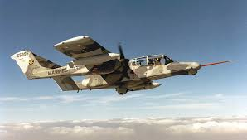
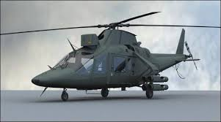





Organization
HPAF
Tactical Divisions and Support Commands
1ST AD
2ND AD
3RD AD
ADC
ALC
AETC
AFRC
600ABW
560ABW
530ABW
5FW
355AEW
AFOS
PAFFS
ARCens
TOGs
TOGs
TOGs
580ACWW
410MW
PAFOCS
NCOS
780GBADG
420SW
AFWR
PAFTSTS
BMTS
ASSW
AFRDC
440AMG
550ABG
Tactical and Support Wings
15SW
205THW
220AW
250PAW
520ABW
570CTW
710SPOW
Air Force Wide-Support and Separate Units
300AISG
505SRG
900AFWG
950CEISG
AFSSG
HSSG
AFAC
AFFC
PAFPMC
API
AFGH
1301DD

Slide 29
VISION A professional and competent Air Force
responsive to national security and development.
Philippine Air Force
FLIGHT PLAN 2022
Build capability to detect, identify, intercept and neutralize intrusions in the PADIZ and West PH Sea from Area Readiness 4
to Area Readiness 3 by 2022.
Breakthrough
Training
Provide training for mission-essential tasks
to support air defense capability upgrade
.
Core Process
ORGANIZATION
TRAINING
EQUIPMENT
AND
RESEARCH & DEVELOPMENT
HUMAN RESOURCE
DOCTRINES
BASE FACILITIES
Support Process
VALUES
FINANCE
MISSION To organize, train, equip, maintain and provide forces to conduct prompt and sustained air operations to accomplish the AFP mission.
Core Values Integrity ◆ Service Above Self
◆ Teamwork ◆ Excellence ◆ Professionalism

Slide 30




Training
Fill-in Rate of Skill Set Requirements of Personnel
Number of Joint and Combined Training Exercises

Slide 31
Training
Skills Set Requirement of Personnel
Pilot Qualifications
Flight Commander
Element Lead
Combat-Ready Pilot
Co-Pilot
Skill Levels
Super-intendent
Technician / Supervisor
Specialist
Apprentice

Slide 32










Training
Unilateral Training Exercises
Joint Training Exercises
Combined Training Exercises

Slide 33
VISION A professional and competent Air Force
responsive to national security and development.
Philippine Air Force
FLIGHT PLAN 2022
Build capability to detect, identify, intercept and neutralize intrusions in the PADIZ and West PH Sea from Area Readiness 4
to Area Readiness 3 by 2022.
Breakthrough
Equipment and R&D
Acquire and upgrade air defense equipment complemented by research and development for Territorial Defense (TD)
.
Core Process
ORGANIZATION
TRAINING
EQUIPMENT
AND
RESEARCH & DEVELOPMENT
HUMAN RESOURCE
DOCTRINES
BASE FACILITIES
Support Process
VALUES
FINANCE
MISSION To organize, train, equip, maintain and provide forces to conduct prompt and sustained air operations to accomplish the AFP mission.
Core Values Integrity ◆ Service Above Self
◆ Teamwork ◆ Excellence ◆ Professionalism

Slide 34







Equipment
Existing Platforms
S-211
F27-500
OV-10
MG520
UH-1
C-130
W-3 SOKOL

Slide 35







On-Going Acquisitions
Sep 2015
Sep 2014
Mar 2015
2016
UH-1
NC-212i
BELL 412EP
CAS Aircraft
2014
2015
2016
Jan 2015
July 2015
2016
C-295
FA-50
AW-109P

Slide 36





Future Platforms
2016
2020
AIR DEFENSE SURVEILLANCE RADAR
GBADS
AEWACS
2016
2017
2018
2019
2020
2021
2022
2017
2019
2021
LRPA
HEAVY LIFT HELI
MRF

Slide 37
Equipment Procurement Schedule
MEASURE | 2015 | 2016 | 2017 | 2018 | 2019 | 2020 | 2021 | 2022 | TOTAL
SAA/LFTA(Int/N) |  | 2 | 10 |  |  | 12 |  |  | 24
Long Range Patrol Aircraft (D/id) |  |  | 2 |  |  | 2 |  |  | 4
ADSRS(D/ID) |  | 2 | 1 | 2 | 1 |  |  |  | 6
Ground Based Air Defense System GBADS(INT/N) |  | 3 |  |  |  | 3 |  |  | 6
Airborne Early Warning and Control System (AEWACS) |  |  |  |  |  | 2 |  |  | 2
Multi-Role Fighter (Int/N) |  |  |  |  |  |  | 4 | 8 | 12
C2 Center |  |  | 1 |  |  |  |  |  | 1
Electronic Countermeasures (ECM) Aircraft |  |  |  |  |  | 2 |  | 2 | 4
AA REFUELER |  |  |  |  |  |  | 1 |  | 1
Medium/Heavy Lift Helicopters |  |  |  |  | 2 |  |  | 2 | 4
TOTAL |  | 7 | 14 | 2 | 3 | 21 | 5 | 12 | 64

Slide 38
STATUS OF PAF MODERNIZATION PROJECTS
Project Name | Qty | Contract Price | Delivery date
RA 7898 Projects
Medium-Lift Fixed Wing Aircraft (MLFWA) (C-295 CASA) | 3 | 5,288,609,983.99 | 23 Oct 2015 - 1 unit 23 Feb 2016 - 1 unit 23 Jun 2016 - 1 unit
Refurbished UH-1 Helicopters | 21 | 1,263,600,000.00 | 21 Sep 2014 - 21 unit
Attack Helicopters (AW-109P) | 8 | 3,441,172,968.000 | 17 Jan 17 Jul 2015 - 8 unit
Light Lift Fixed-Wing Aircraft NC-212i | 2 | 813,000,000.00 | 12 Mar 2015 - 1 unit 12 Sep 2015 - 1 unit
SAR Basing & Hangarage | 2 | 146243488.76 | 24-May-15
Sub-Total | 36 | 10,952,626,440.75
RA 10349 Projects
Combat Utility Helicopters (CUH) (Bell-12EP) | 8 | 4,800,000,000.00 $105,936,879.00 | 16 Aug – 16 Dec 2015 (6-unit) 16 Jan 2016 (2-unit)
Fighter/Surface Attack/Lead-in Fighter Trainer (F/SA/LIFT) Aircraft (FA-50) | 12 | 18,976,000,000.00 | Jan 2016 (2) Jan - Aug 2017 (10)
Sub-Total | 20 | 23,776,000,000.00
TOTAL | 56 | 34,728,626,440.75

Slide 39














Research & Development
PAF Mobile Communication Medium
2016 - 2017
2018 - 2019
2020
2021
2022

Slide 40
VISION A professional and competent Air Force
responsive to national security and development.
Philippine Air Force
FLIGHT PLAN 2022
Build capability to detect, identify, intercept and neutralize intrusions in the PADIZ and West PH Sea from Area Readiness 4
to Area Readiness 3 by 2022.
Breakthrough
Core Process
ORGANIZATION
TRAINING
EQUIPMENT
AND
RESEARCH & DEVELOPMENT
Human Resource System
Provide and sustain the best talents for air defense prioritizing Air Defense Organization
.
HUMAN RESOURCE
DOCTRINES
BASE FACILITIES
Support Process
VALUES
FINANCE
MISSION To organize, train, equip, maintain and provide forces to conduct prompt and sustained air operations to accomplish the AFP mission.
Core Values Integrity ◆ Service Above Self
◆ Teamwork ◆ Excellence ◆ Professionalism

Slide 41




Human Resource System

Slide 42
VISION A professional and competent Air Force
responsive to national security and development.
Philippine Air Force
FLIGHT PLAN 2022
Build capability to detect, identify, intercept and neutralize intrusions in the PADIZ and West PH Sea from Area Readiness 4
to Area Readiness 3 by 2022.
Breakthrough
Core Process
ORGANIZATION
TRAINING
EQUIPMENT
AND
RESEARCH & DEVELOPMENT
Doctrine and Knowledge System
Develop doctrines relevant to air defense operations at the strategic, operational and tactical levels
HUMAN RESOURCE
DOCTRINES
BASE FACILITIES
Support Process
VALUES
FINANCE
MISSION To organize, train, equip, maintain and provide forces to conduct prompt and sustained air operations to accomplish the AFP mission.
Core Values Integrity ◆ Service Above Self
◆ Teamwork ◆ Excellence ◆ Professionalism

Slide 43

Doctrine and Knowledge System
To publish the doctrines for Territorial Defense Operations at the strategic, operational and tactical levels.
 | 2016 | 2017 | 2018
Units/Organizations with Required Doctrine | 3 / 9 | 6 / 9 | 9 / 9
Percentage | 33% | 66% | 100%

Slide 44
VISION A professional and competent Air Force
responsive to national security and development.
Philippine Air Force
FLIGHT PLAN 2022
Build capability to detect, identify, intercept and neutralize intrusions in the PADIZ and West PH Sea from Area Readiness 4
to Area Readiness 3 by 2022.
Breakthrough
Core Process
ORGANIZATION
TRAINING
EQUIPMENT
AND
RESEARCH & DEVELOPMENT
Bases and Support System
Upgrade base facilities and support system following an approved master development plan
HUMAN RESOURCE
DOCTRINES
BASE FACILITIES
Support Process
VALUES
FINANCE
MISSION To organize, train, equip, maintain and provide forces to conduct prompt and sustained air operations to accomplish the AFP mission.
Core Values Integrity ◆ Service Above Self
◆ Teamwork ◆ Excellence ◆ Professionalism

Slide 45




Bases and Support System
Paredes AS
Crow Valley GR
Basa AB
Subic
Villamor AB
Fernando AB
Gozar AS
Parañal AS
Antonio Bautista AB
Salakot AS
Anini-y
Lumbia
Edwin Andrews AB
Balut Island
Sanga-Sanga AS

Slide 46
VISION A professional and competent Air Force
responsive to national security and development.
Philippine Air Force
FLIGHT PLAN 2022
Build capability to detect, identify, intercept and neutralize intrusions in the PADIZ and West PH Sea from Area Readiness 4
to Area Readiness 3 by 2022.
Breakthrough
Core Process
ORGANIZATION
TRAINING
EQUIPMENT
AND
RESEARCH & DEVELOPMENT
HUMAN RESOURCE
DOCTRINES
BASE FACILITIES
Support Process
Values System
Pursue military values towards effective mission performance of Strategic Units
VALUES
FINANCE
MISSION To organize, train, equip, maintain and provide forces to conduct prompt and sustained air operations to accomplish the AFP mission.
Core Values Integrity ◆ Service Above Self
◆ Teamwork ◆ Excellence ◆ Professionalism

Slide 47



Three Pillars
Values System
Awareness of self
Awareness of others
Awareness of country and environment
  Integrity
  Excellence
  Service above self
  Teamwork
  Professionalism
    Love of Country
    Caring for the Environment
    Loyalty to the Organization

Slide 48
VISION A professional and competent Air Force
responsive to national security and development.
Philippine Air Force
FLIGHT PLAN 2022
Build capability to detect, identify, intercept and neutralize intrusions in the PADIZ and West PH Sea from Area Readiness 4
to Area Readiness 3 by 2022.
Breakthrough
Core Process
ORGANIZATION
TRAINING
EQUIPMENT
AND
RESEARCH & DEVELOPMENT
HUMAN RESOURCE
DOCTRINES
BASE FACILITIES
Finance and Stakeholders’ Support
Secure stakeholders’ support to generate adequate funding for the Flight Plan
Support Process
VALUES
FINANCE
MISSION To organize, train, equip, maintain and provide forces to conduct prompt and sustained air operations to accomplish the AFP mission.
Core Values Integrity ◆ Service Above Self
◆ Teamwork ◆ Excellence ◆ Professionalism

Slide 49
Good Governance Initiatives
Transparency and Accountability
Commercial Claims and Payment System
Database Management System
QUASAR
Financial and Collateral Payment System

Slide 50
Funding Requirement
 | Exp. Class | Territorial Defense Required Budget Per Year (in Php Billions)
 |  | 2014 (BL) | 2015 | 2016 | 2017 | 2018 | 2019 | 2020 | 2021 | 2022
GAA | PS | 1.91 | 2.51 | 3.16 | 3.50 | 3.80 | 4.20 | 4.40 | 4.50 | 4.60
 | CO | .04 | .78 | .72
 | MOOE | .67 | .70 |  | .75 | .78 | .82 | .85 | .88 | .92
Supp/Modernization | CO |  | 2.57 | 33.77 | 47.34 | 59.68 | 14.32 | 56.63 | 26.42 | 59.58
 | MOOE |  | .13 | .76 | 3.13 | 2.65 | 3.24 | 4.25 | 4.77 | 6.17
Total |  | 2.62 | 6.69 | 38.41 | 54.72 | 66.91 | 22.58 | 66.13 | 36.57 | 71.30
Total Budget Requirement 2015-2022: Php 363.71B

Slide 51
Proposed Budget Allocation FY 15
Source: National Expenditure Program 2015

Slide 52
Defense Spending as Percentage of GDP (2013)
Source: The World Bank, Military Expenditure (% of the GDP)
Notes:
http://data.worldbank.org/indicator/MS.MIL.XPND.GD.ZS/countries

Slide 53
Capability Development
Equipment
2015
2016
2017
2018
2019
2020
2021
2022
Organization
ADC established
Training
Pitch Black
Red Flag
Cobra Gold
Doctrines
100% Required Doctrines completed
Human Resources
100% Fill up rate
Bases Development
MDP upgrades implemented
Finance
Generated fund support
Values
Professional and Competent Air Force

Slide 54


Early Gains and Quick Wins
Alignment with the AFP Transformation Roadmap
Formulation of a Breakthrough Goal
Crafting of a Strategic Flight Plan

Slide 55


Way Ahead
Conferment of “Compliant” Status
Scorecard Cascading Session
Multi-Sector Governance Council

Slide 56

Timeline for Next PGS Stages
PGS Governance Pathway
Results through Governance Systems translated to everyday operations
INSTITUTIONALIZED
Mar 2017
PROFICIENT
Office of Strategy Management, Strategy Review and Monitoring
Mar 2016
COMPLIANT
Subsidiary Scorecards & Stratex, Multi-Sector Governance Coalition
Mar 2015
INITIATED
Charter, Road Map, Scorecard, Strategic Initiatives
Oct 2014
PGS PATHWAY
HALLMARK
TARGET DATE

Slide 57
Conclusion
The PAF Flight Plan is more than just buying the best or the right equipment.
It is likewise having the right organizational structure as well as base infrastructure.
More importantly, it is about professionalization and building competence; it is training people and units and retaining the technical capability gained.
Stakeholder support to sustain these measures.

Slide 58

Conclusion
Call for support for the Flight Plan 2028 to realize our “vision of a Professional and Competent Air Force Responsive to National Security and Development.”

Slide 59
Maraming Salamat Po!

